Slide 1
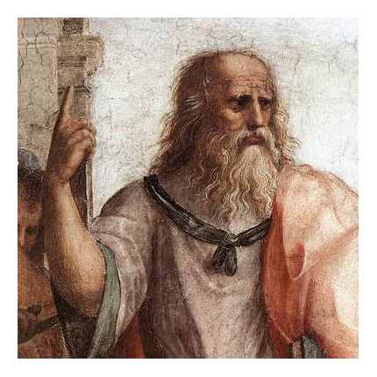
HUMA2921 Ethical Theories and Contemporary Issues
Prof. Plato Tse
NCCU & HKUST

Slide 2
Virtue Ethics
In moral thought, we look to individuals as models, e.g., Jesus, Buddha, Socrates, Mother Theresa, nelson Mandela, and Martin Luther King etc.
The qualities that characterize such persons are called virtues.
Moral theories that take virtue to be central for understanding morality are called virtue ethics.

Slide 3
What is virtue?
A relatively fixed trait of character or mind
Involves dispositions to think, reason, feel, and act in certain ways across a range of different circumstances
Central in the positive evaluation of the moral worth of persons

Slide 4
What is virtue?
Three Components (honesty):
Intellectual component
Correct beliefs about when telling the truth is appropriate
Affective component
E.g., disposed to feel and express approval toward those who tell the truth
Motivational-behavioral component
E.g., disposed to tell the truth and avoid telling lies

Slide 5
What is virtue?
Acquired by practice and exercise (≠ naturally endowed excellences)
Virtues could be hierarchically arranged.
Cardinal virtues:
Not dependent on other virtues
Other virtues are subordinate to them
Greek: Wisdom, courage, temperance, and justice
Christian: faith, hope, and love, prudence, fortitude, temperance, and justice

Slide 6
Aristotle on Virtue and the Good Life
Nicomachean Ethics
Human activities all aim at some end, or good.
The highest good would be that end (or set of ends) that is most choice-worthy.
Unconditionally complete
Self-sufficient

Slide 7
The Function Argument
The highest good of human beings concerns their purpose or function as human beings.
The purpose or function of human beings concerns what is distinctive of such beings.
Rationality is distinctive of humans and hence its exercise is central in understanding the function of human beings.
The highest good of human beings involves the rational exercise of the soul (mind).
The good of a thing is that thing performing its function well, which, for humans, involves rational activity guided by virtue.
The highest good of human beings is a life of rational activity of the soul guided by virtue.

Slide 8
Eudaimonia
Standardly translated as “happiness” or “flourishing” and occasionally as “well-being”
“flourishing” applies to animals and plants, but eudaimonia is possible only for rational beings
“happiness” in ordinary usage is subjectively determined, but flourishing is not.

Slide 9
Eudaimonia
A moralized or value-laden concept of happiness
Living in accordance with virtue is necessary for eudaimonia.
For Aristotle, virtue is necessary but not sufficient for a eudaimon life.
For the Stoics, virtue is both necessary and sufficient for a eudaimon life.

Slide 10
Doctrine of the Mean
“[V]irtue is about feelings and actions, in which excess is in error and deficiency is blamed, whereas the intermediate condition is praised and is correct which are both proper features of virtue. Virtue, then, is a mean insofar as it aims at what is intermediate” (NE, 1106b).

Slide 11
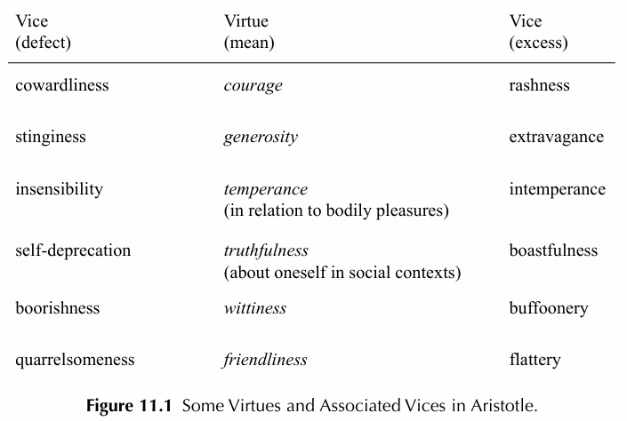
Doctrine of the Mean

Slide 12
Phronesis
Practical intelligence (phronesis):
The capacity to determine the right manner of feeling and action in contexts that call for some sort of virtuous response
A higher-order virtue
Comes only with experience of life
Morally mature adult vs nice children

Slide 13
Unity of Virtues
Suppose a person is on a military campaign where food and water must be rationed.
Justice requires that she take only her fair share of supplies. Unless this person is also temperate, she will be disposed to unjustly take more than her fair share. Thus, being a truly just person requires that one also be temperate.

Slide 14
Virtue Ethics
VE: Facts about virtuous agents, including their virtuous character traits and how such traits influence their reactions (1) are more basic than facts about right conduct and (2) explain why an action is right or wrong.
Qualified agent-based: based on a hypothetically virtuous person who possesses all of the moral significant virtues and consistently act on them

Slide 15
Virtue Ethics
An action A in C is obligatory iff any ideally virtuous agent would not fail to do A in C.
An action A in C is wrong iff no ideally virtuous agent would perform A in C.
An action A in C is optional iff some ideally virtuous agent might or might not perform A in C.

Slide 16
No fundamental rules, no conflict?
Derive from each virtue a virtue rule (for the virtue of kindness, the rule is “Be kind”)
Since VE features a plurality of cardinal virtues, there would be a plurality of virtue rules.
Conflicts arise when two or more virtue considerations are relevant and indicate incompatible courses of action.
Virtue Ethics

Slide 17
Evaluation
Imagine a mendacious person who is a compulsive liar, even about trivial matters that cause little or no harm to others. He has the vice of dishonesty. At some point in life, he becomes convinced that he ought to change because he comes to see mendacity as a vice and honesty as a trait one ought to have. But to bring about this personal change, he cannot simply say to himself with conviction, “ok, from now on I won’t tell lies”; he knows better. What he must do is engage in a regimen that involves taking concrete steps such as writing down lies that he tells and reflecting on their true significance, rewarding himself at the end of those days in which he tells no lies, and other such tactics. But none of these concrete activities are characteristic of what an ideally virtuous agent would engage in.

Slide 18
An action A performed in circumstance C is obligatory iff any ideally virtuous agent would advise one to not fail to do A in C.
Another counterexample:
Consider an obstinate person who is determined to do just the opposite of what anyone advises him to do. An ideally virtuous person knowing this might strategically advise this person to not do. A believing that this (false) advice will prompt him to do A. So, what any ideally virtuous agent would advise this person to do is not what he ought to do.
Evaluation

Slide 19
Personal relationships are paradigmatic for all of morality.
E.g. between parents and their children, siblings, friends, and spouses
Involve care
Inspired by the psychologist Carol Gilligan’s 1982 book, In a Different Voice.
Care Ethics

Slide 20
Care Ethics
Justice vs Care
Conception of the self
Justice: individuality
Care: relatedness
Nature of moral problems
Justice: takes inequality to be the central issue
Care: takes disconnection and abandonment to be central
Moral reasoning
Justice: impartiality
Care: sensitivity

Slide 21
Two senses of care
Caring about: To care about something or someone involves “being invested” in that thing or person.
Caring for: In the context of care ethics, this expression aptly applies to the actions of a person
Relationships and Care

Slide 22
Relationships and Care
Not all forms of relationship and care are equally morally valuable
Think about forms of care that stifle the development of the person
Not necessarily restricted to existing personal relationships
Advocates argue that one’s responsibilities of care are global and that one ought to extend care to others

Slide 23
Joan Tront’s five care stages, articulated in her books Moral Boundaries (1993) and Caring Democracy (2013):
Attentiveness (Caring About):
Recognizing that a need exists
Overcoming moral blindness
Responsibility (Taking Care Of):
Moving from “someone should do something” to “I/We must ensure this is done”
Relationships and Care

Slide 24
Relationships and Care
Competence (Care-Giving):
Ensuring that the care provided actually meets the need
Responsiveness (Care-Receiving):
Considering the receiver’s perspective and being alert to potential abuses of power
Solidarity (Caring With):
Recognizing that care is a collective responsibility of citizenship

Slide 25
CE not a complete moral theory. Stephanie Collins:
“[C]are ethics is not a theory of the whole of morality. Morality includes duties that arise out of harming others, out of receiving benefits, out of making promises and contracts, and so on. It also includes duties not to interfere with others. These are all important duties—but they are not duties of care ethics” (2020, 98).
Care Ethics and Moral Theory

Slide 26
Care Ethics and Moral Theory
Two care ethics principles:
Dependency principle. When an important interest is unfulfilled and you’re capable of fulfilling that interest, and fulfilling the interest will not be too costly, then you have a responsibility to fulfill the interest. (Collins 2015, chapter 6)
“Important interest” includes material as well as non-material needs.

Slide 27
Two care ethics principles:
Principle of subsidiary. We should shift the actual delivery of care whenever possible to the most local and personal levels. We should care for others whenever possible by enabling them to care for themselves. (Engster 2007, 58)
The application of these principles must be guided by emotional attunement.
Care Ethics and Moral Theory

